Slide 1



SAGE SCHOOL OF COMPUTER APPLICATION
Department of Computer Application
PBL Presentation on
WAR LEAGUE
(GAME DEVELOPMENT)
Under the Supervision of: Bhavesh Shah
Lokesh Sahu
Asst. Prof., Dept. of CA, SSOCA
Presented by:
Vedant Kurchania
Aditya Nair
Kanishk Shrotriya

Slide 2

Outline
Introduction
Literature Survey
Objective & Motivation
Problem Definition & Proposed Work
Implementation & Result Analysis
Conclusion And Future Work
Reference

Slide 3

Introduction
FPP , Indie , Shooter , Low Poly , Competitive , Tactical.
To play a low poly , FPP shooting game on minimum requirements system.
Any person with stable internet and i5 system , no DGPU required.

Slide 4

Literature Survey
Valorant , CSGO , KRUNKER.IO
High Requirement System is not required , LAN CONNECTIVITY No Global server required as we can connect with LAN / IP address.

Slide 5

Objective & Motivation
To Play a Low requirement game with Lan connectivity Max (2-4 Players).
UI Friendly , Easy to learn , 13+ Rated.

Slide 6

Problem Definition & Proposed Work
In this Genre , most of the games are high-end (made with unreal engine) , but this game will be low poly and light on systems which will avoid heating problems and heavy load on cpu , gpu .
We have used Blender and Maximo Fuse for Character Building / Creation and Unity 3D Engine For Game Development.

Slide 7

IMPLEMENTATION & RESULT ANALYSIS
System/User requirements : Minimum : i3 – 7200U , Intel UHD Graphics 600 , Around 3-5 Gb HDD
space required.
Recommended : i5 – 9th GEN , Nvidia GTX 800 , SSD will be better.
*Stable Internet Connectivity Required*.

Slide 8

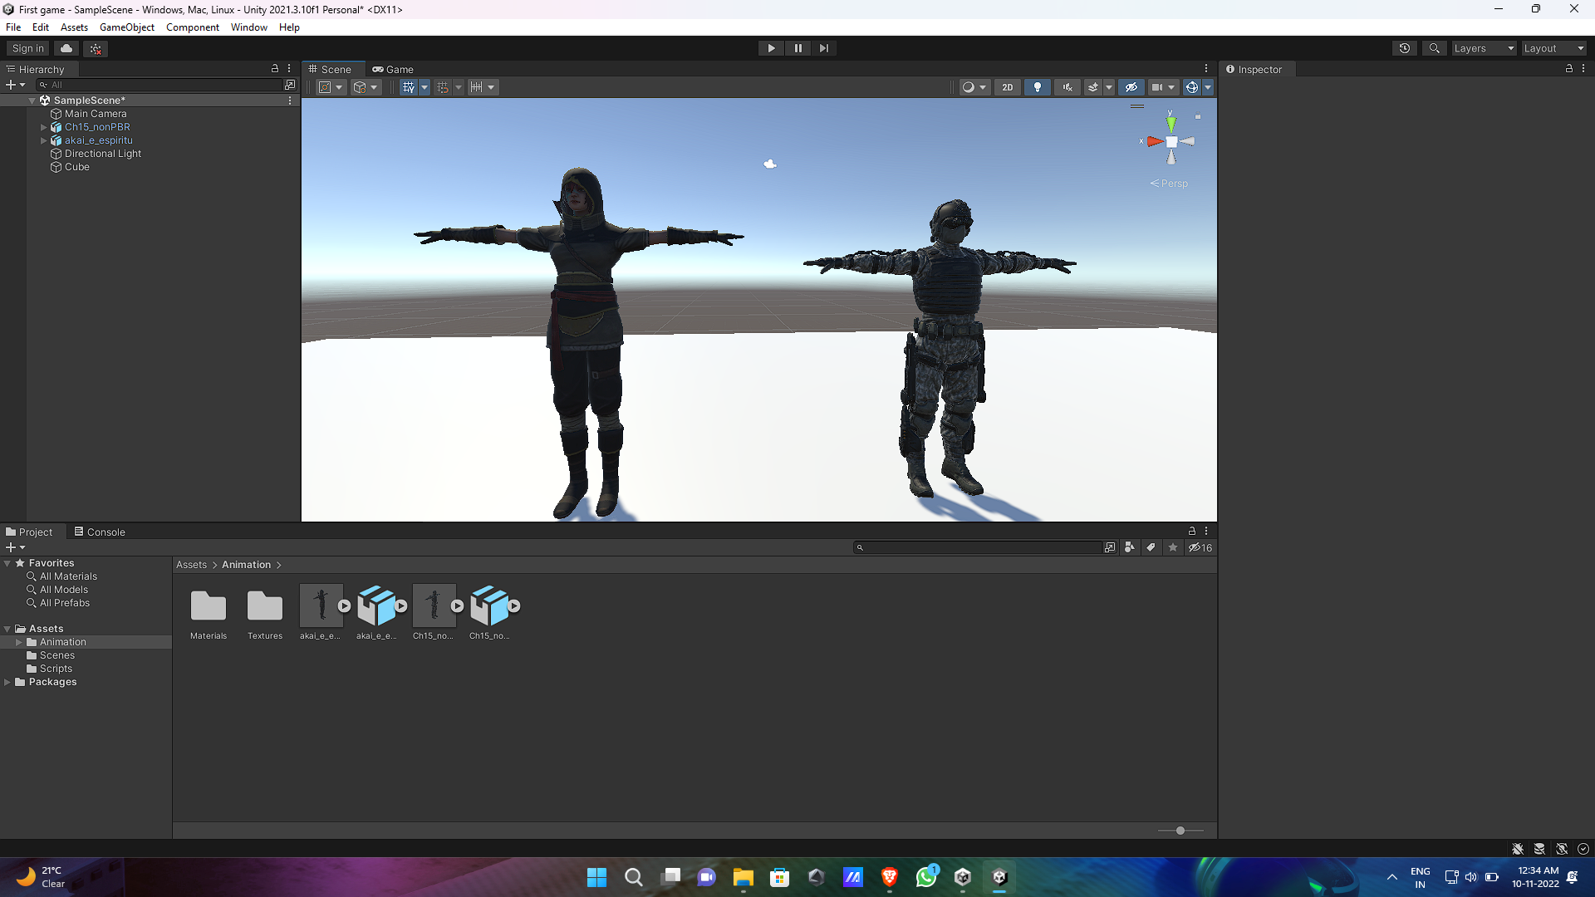
Snapshots of system


Slide 9
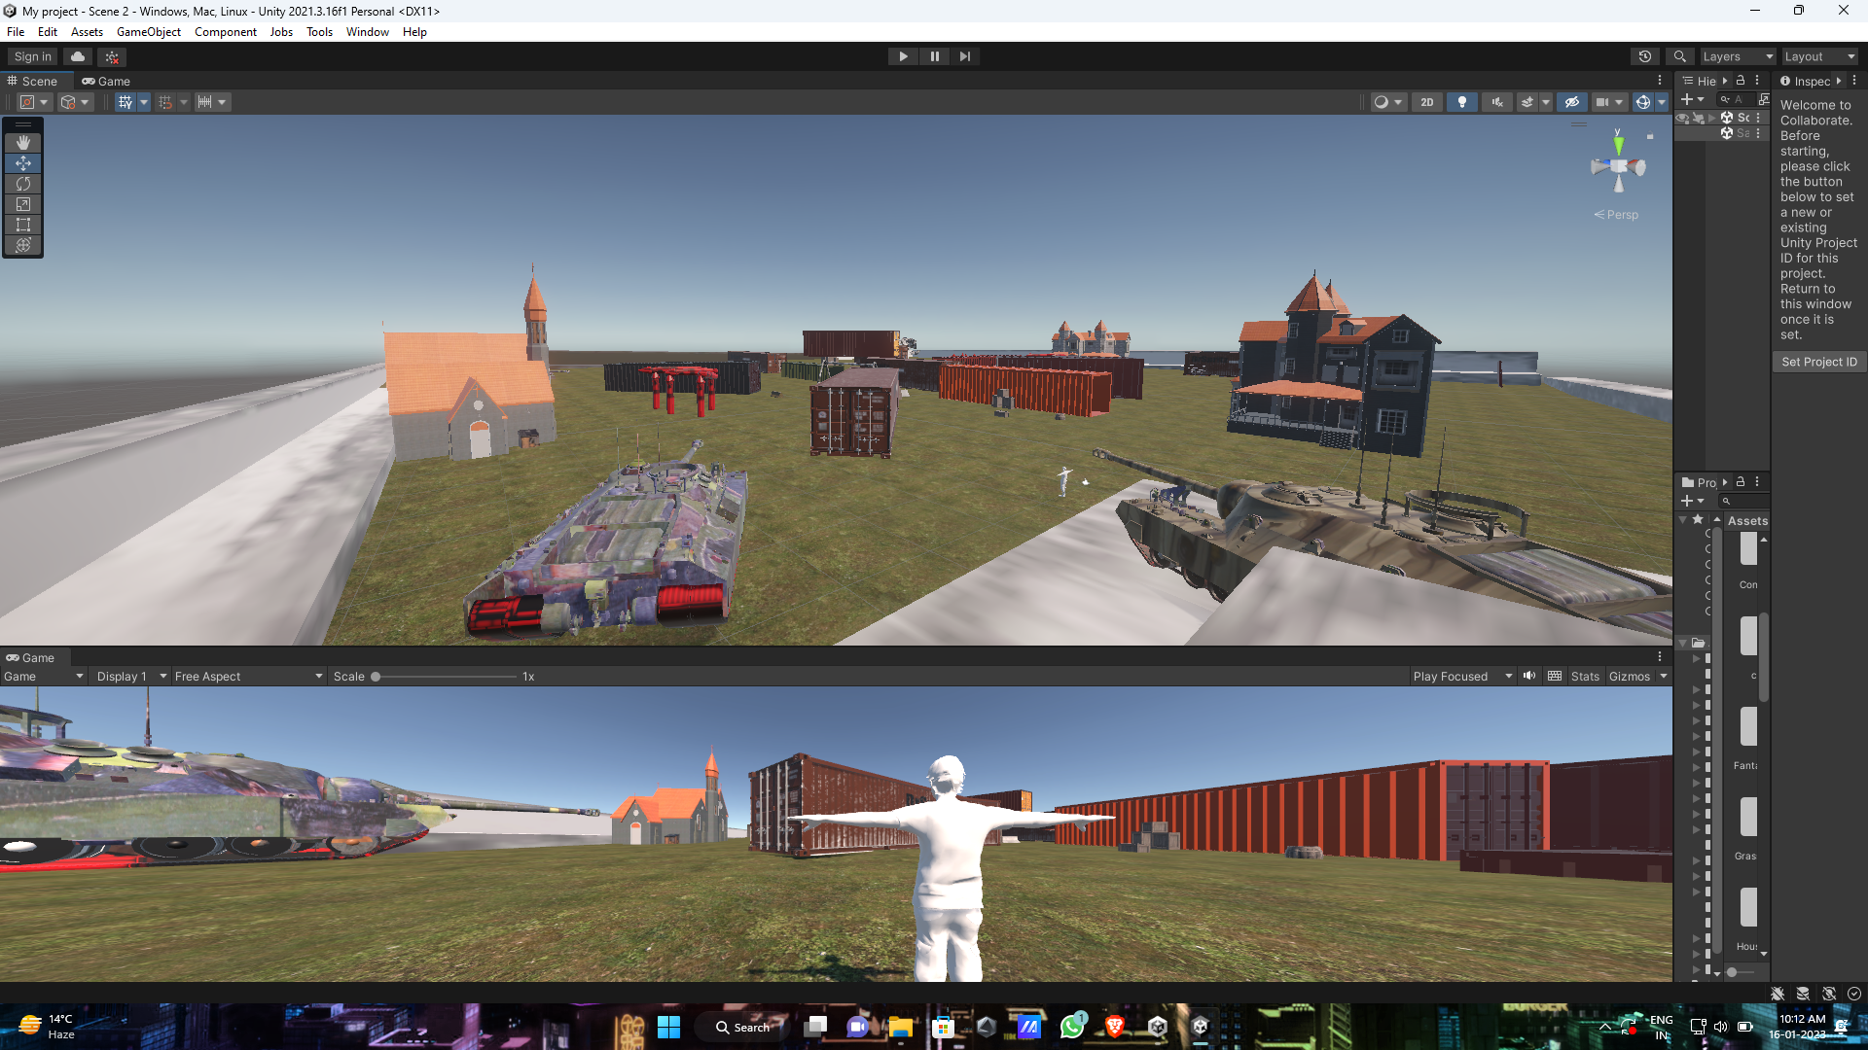
Snapshots of system

Slide 10
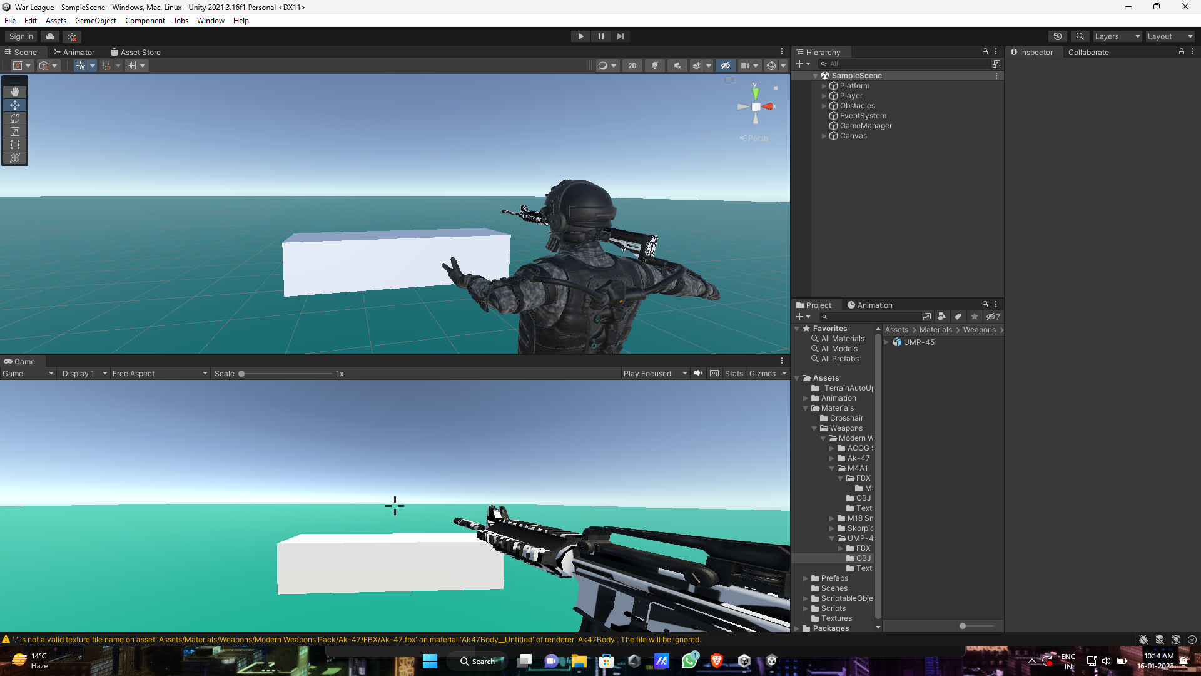
Snapshots of system

Slide 11
Future Work
We will add new Characters , Dynamic Environment , New Maps , Bugs and glitch Fixes and many more updates in the future.

Slide 12

Conclusion
 I In this project , it will be low violence , Easy to understand Mechanism and Low system Requirements needed .
Players can be able to play FPP shooting game on old pcs without lag.

Slide 13

References
https://unity.com/
https://www.blender.org/
https://www.mixamo.com/
https://www.adobe.com/in/products/indesign
https://www.adobe.com/in/products/indesign.html?
https://www.adobe.com/in/products/character-animator.html

Slide 14
THANK YOU

